Slide 1
Engineering Chemistry F. Y. B. Tech.
Dr. Jitendra Satam

Slide 2

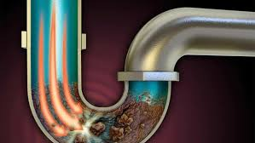
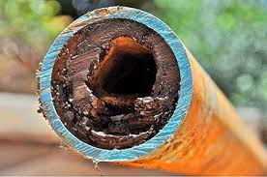
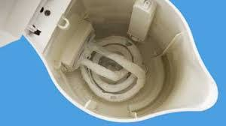
Hard water in industry

Slide 3
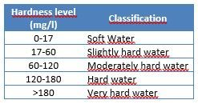
Classification of Hardness

Slide 4
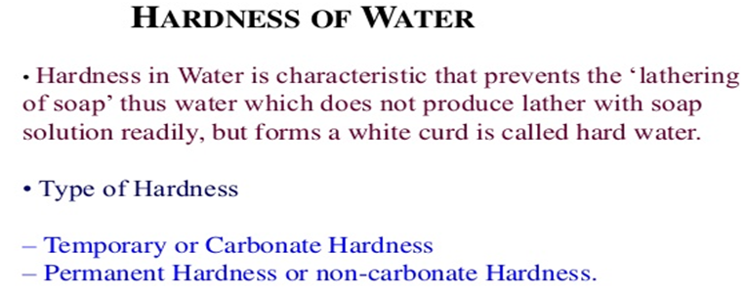
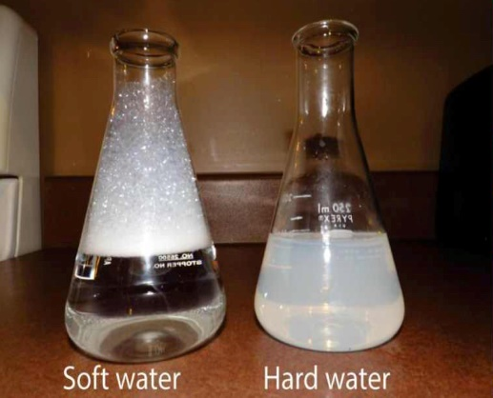

Slide 5
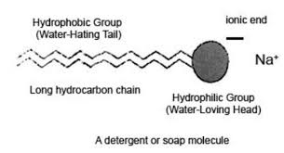
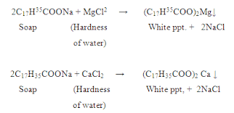
Reaction of Soap with Water

Slide 6
How to detect hardness?
When the water is treated with soap solution, if it prevents lathering and forms white scum, the water contains hardness. Or Water containing hardness, gives wine red colour with Eriochrome Black –T indicator.
Although water hardness usually measures only the total concentrations of calcium and magnesium (the two most prevalent, divalent metal ions), iron, aluminum and manganese may also be present at elevated levels in some geographical locations. The predominant source of magnesium is dolomite [Ca-Mg(CO₃)₂].

Slide 7
TYPES OF HARDNESS
Depending upon the types of dissolved salts present in water, hardness of water can be classified into two types:
Temporary Hardness
(Carbonate hardness or Alkaline hardness)
Permanent Hardness
(Non carbonate hardness or Non alkaline hardness)

Slide 8
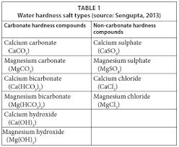
Types of Hardness

Slide 9
Temporary Hardness (or) Carbonate Hardness
(or) Alkaline Hardness
Temporary hardness is caused by carbonate, bicarbonate and hydroxide of calcium and magnesium ions in the water.
It can be removed by boiling water or by the addition of lime [Ca(OH)₂]
Boiling promotes the formation of carbonate from the bicarbonate and precipitates calcium carbonate out of solution, leaving water that is softer upon filtration and removal of residue.
Ca(HCO₃)₂→ CaCO₃ ↓+ H₂O + CO₂

Slide 10
Permanent Hardness or Non – Carbonate Hardness (or) Non – alkaline Hardness
Permanent hardness is hardness (mineral content) that cannot be removed by boiling.
It is usually caused by the presence of sulphates, chlorides, nitrates of calcium and magnesium and other metal ions which become more soluble on boiling.
Despite the name, permanent hardness can be removed using water – softener or ion-exchange column, where the calcium and magnesium ions are exchanged with the sodium ions in the column. It can be removed by
Lime – Soda process
Zeolite process

Slide 11
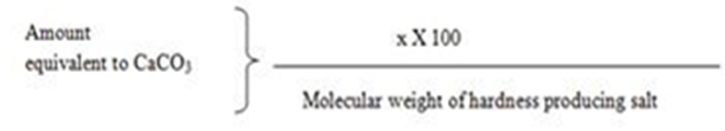
Expression of hardness in terms of
equivalents of CaCO₃
The concentrations of hardness producing salts are usually expressed in terms of equivalent amount of CaCO₃.
CaCO₃ is chosen as a standard because, Its molecular weight (100) and equivalent weight (50) is a whole number, so the Calculations in water analysis can be simplified.
It is the most insoluble salt, that can be precipitated in water treatment.
If the concentration of hardness producing salt is x mg/lit.

Slide 12
Expression of hardness in terms of equivalents of CaCO₃
CaCO₃ Equivalent Hardness (ppm) =
= Mass of Hardness Producing substance x Chemical equivalents of CaCO₃ / Chemical equivalents of Hardness causing salt.
How many grams of FeSO₄ dissolved per litre gives 210 ppm hardness?
Calculate temporary hardness and permanent hardness of water sample from the following data:
Mg(HCO₃)₂ = 16 mg/L, MgCl₂ = 19 mg/L, MgSO₄ = 2.4 mg/L, Mg(NO₃) ₂ = 2.96 mg/L, Ca(HCO₃) ₂ = 8.1 mg/L, SiO₂ = 16 mg/L

Slide 13
UNITS OF HARDNESS
Parts per million (ppm):
It is defined as the number of parts of CaCO₃ equivalent hardness per 1000000 parts of water.
Milligrams per litre (mg/lit):
It is defined as the number of milligrams of CaCO₃ equivalent hardness per 1 litre of water.

Slide 14
Clarke’s degree (ºCl)
It is defined as the number of parts of CaCO₃ equivalent hardness per 70,000 parts of water.
French degree (ºFr)
It is defined as the number of parts of CaCO₃ equivalent hardness per 105 parts of water.
Relationship between various units
1 ppm = 1 mg/lit = 0.10 ºFr = 0.070 ºCl

Slide 15
ESTIMATION OF TOTAL HARDNESS OF WATER BY EDTA METHOD
Principle:
The calcium and other metal ions present in the water are capable of forming complex with Indicator EBT and also with the EDTA in the pH range 8 - 10.
To keep the solution at this pH range, a buffer [mixture of ammonium chloride and ammonium hydroxide] is used.
The complex between Metal-EDTA is more stable than that of between the Metal-indicator (EBT).

Slide 16
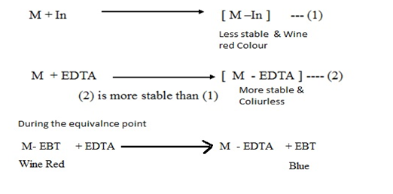

Slide 17
50 mL SHW = V₁ mL EDTA
50 x 1 mg of CaCO₃ = V1 mL EDTA
Hence, 1 mL EDTA = 50/V₁ mg CaCO₃ eq.
Now 50 mL of given hard water = V₂ mL of EDTA
= V₂ x 50/V₁ mg CaCO₃ eq.
1 L of given hard water = 20 x V₂ x 50/V₁ mg CaCO₃ eq.
Total Hardness of water = 1000 V₂/V₁ ppm
Now, 50 mL of boiled water = V₃ mL of EDTA
= V₃ x 50/V₁ mg CaCO₃ eq.
1 L of boiled hard water = 20 x V₃ x 50/V₁ mg CaCO₃ eq.
Permanent Hardness = 1000 V₃/V₁ ppm

Slide 18
Sample A = 14.6 mg of Mg(HCO₃)₂ per litre
Sample B = 820 mg of Ca(NO₃)₂ and 2 mg NaNO3
Sample C = 20 g Silica and 16.2 mg Ca(HCO₃)₂ per 500 ml
Determine the hardness of samples A, B, C ?

Slide 19
Numerical on EDTA method
a) 0.28 g of CaCO₃ was dissolved in HCl and the solution is diluted to 1 litre.
100 mL of the above solution required 28 mL of EDTA solution.
100 mL of unknown hard water sample required 33 mL of EDTA solution.
After boiling, cooling and filtration 100 mL of this solution on titration required 10 mL of EDTA solution. Calculate all types of hardness.

Slide 20
Numerical on EDTA method
b) 55.5 mg of CaCl₂ is dissolved in 750 ml of distilled water and 50 ml of this water on titration required 14 ml of EDTA.
100 ml of water sample on titration with same EDTA required 9.8 ml.
50 ml of boiled water sample on titration required 2.7 ml of same EDTA. Calculate the all types of hardness.

Slide 21
750 ml of SHW = 55.5 mg of CaCl₂
= (55.5 / 750) x 100/111 mg of CaCo₃
1 ml of SHW = 0.067 mg of CaCO₃
50 ml of SHW = 14 ml of EDTA
1 ml of EDTA = 50 /14 ml of SHW
= 50 /14 x 0.067 mg of CaCO₃
1 ml of EDTA = 0.24 mg of CaCO₃

Slide 22
Total Hardness
100 ml of water sample = 9.8 ml of EDTA = 9.8 x 0.24 mg of CaCO3
Total hardness = 9.8 x 0.24 x 1000/100 mg /L = 23.52 ppm or mg /l

Slide 23
c) 50 mL sample of water required 8.2 mL of M/20 Disodium EDTA solution for titration. After boiling and filtration the same volume required 4.5 mL of EDTA. Calculate all types of hardness.
M/20 EDTA = 0.05 M EDTA
1000 mL 1 M EDTA = 100 g CaCO₃
1 mL, 1 M EDTA = 100 mg CaCO₃
50 mL water sample = 8.2 mL of 0.05 M EDTA
1000 mL water sample = 20 x 8.2 M of 0.05 M EDTA
= 164 mL of 0.05 M EDTA
1 mL, 1 M EDTA = 100 mg CaCO₃
164 mL of 0.05 M EDTA = 164 x 0.05 x 100
= 820 ppm = Total Hardness

Slide 24
Now, 50 mL of boiled water = 4.5 mL of 0.05 M EDTA
1000 mL water sample = 20 x 4.5 M of 0.05 M EDTA
= 90 mL of 0.05 M EDTA
As, 1 mL, 1 M EDTA = 100 mg CaCO₃
90 mL of 0.05 M EDTA = 90 x 0.05 x 100
= 450 ppm = Permanent hardness
Temporary hardness = 820 – 450 = 370 ppm

Slide 25
d) 25 mL sample of water required 5.5 mL of M/10 Disodium EDTA solution for titration. After boiling and filtration 50 mL of water sample required 3.9 mL of EDTA. Calculate all types of hardness.

